Slide 1

Level 3 BTEC Extended Certificate
Early Childhood Development
Passport to Sixth Form
Name: ________________________

Slide 2
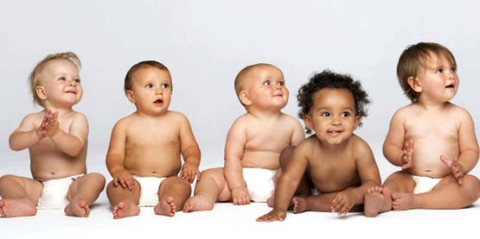
Contents
What will I be studying? Page 3
Theorists that study child development Page 5, 6, 7
Social stages of play Page 8
True or false Page 9
Key word glossary Page 10-11
Factors affecting growth Page 12-13
Research careers Page 15, 16
Recommended Netflix and TV programmes Page 17, 18
Passport checklist for September Page 19

Slide 3

What will I be studying?
To achieve this qualification, you must successfully complete 4 compulsory units. This qualification is equivalent in size to one A Level. There are four units; two of these are external, this means these are exams. This qualification gives an introduction to study of the early years setting sector and will enable you to apply for a wide range of degree courses or support progression to higher education; however, this qualification will also be relevant to progress directly to employment, through an Early Years Educator Apprenticeship.
EXAMS
Unit 1: Children’s Development (90GLH)
You will explore children’s developmental progress from birth up to eight years. You will examine theories, principles and factors relating to development.
Unit 2: Keeping Children Safe (90GLH)
You will explore the responsibilities of a professional to maintain health and safety as well as ensuring effective safeguarding measures are in place. You will gain an understanding of what to do in an emergency and when to address concerns about a child’s welfare.
COURSEWORK
Unit 3: Play and Learning (90GLH)
You will explore the concept of play, the influence of theories and approaches to play, and the benefits of play and learning activities for children.
Unit 4: Research and Reflective Practice in an Early Childhood Setting (90GLH)
You will gain an understanding of how research findings influence policy and provision for children and you will be able to reflect on how this influences on your own behaviour and expectations in the work placement environment.

Slide 4



Research task
Throughout the AAQ Level 3 Early Childhood Development course you will learn about
a number of theorists.
These theorists are important across all units, therefore it is important that you fully understand the main points of what the theorists say and how this applies to how children develop and learn.
Research the following theorists and produce a fact file on each one, watch the video clips to help you:
Skinner
To include.. positive reinforcement, praise, repeat behaviour
Chomsky
To include.. Language Acquisition Device (LAD) and the concept of critical period
https://www.youtube.com/watch?v=7Cgpfw4z8cw
Bowlby
To include.. development of attachment, internal working models (IWMs)
https://www.youtube.com/watch?v=P-wh2AEhlOc

Slide 5

Research task
Skinner

Slide 6
Research task
Chomsky

Slide 7
Research task
Bowlby

Slide 8
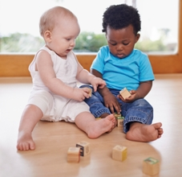
Social Stages of Play
In the 1930s, Mildred Parten looked at young children’s play. She noticed that as children become older, they tend to play more cooperatively. Her work has been widely accepted as it showed that children’s social development was reflected in the way they played.
Complete the table below to discover the different ways that children play as they grow older and develop their skills. Research Mildred Parten’s Social Stages of Play to complete the missing information.
Age | Stages of Play | Characteristics
0-2 years | Onlooker
0-2 years | Solitary
2-3 years
3-4 years
4 years and onwards

Slide 9
Child Development- Quick Quiz
True or False?
True
Colour code the statements in order to show if they are true or false.
False
It is a legal requirement to be assigned a key person in an early years setting
Babies born prematurely are more likely to develop learning difficulties
1
2
Babies typically start to walk and say their first words at 12 months
Children will all develop at the same rate
4
3
Choose one of the above statements and explain why you think it is true or false..
The environment that a child is brought up in can impact how they develop
5

Slide 10

Task: Research and define the following words which are central to child development.
Term | Definition
Adolescence | An important status change following the onset of puberty during which a young person develops from a child into a adult.
Adult-Initiated Play
Attachment
Care Plan
Child- Initiated Play
Development
Discrimination
Diversity
Empathy
Ethical

Slide 11
Term | Definition
Fine Motor Skills
Growth
Key Person
Milestone
Nature
Nurture
Risk Assessment
Safeguarding
Self-Concept
Self-Esteem

Slide 12
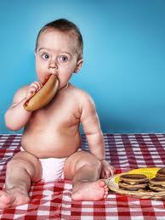
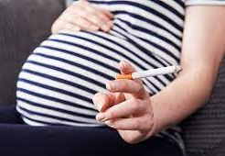
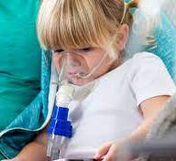
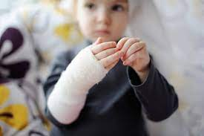
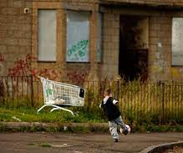
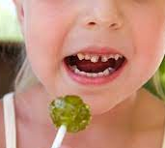

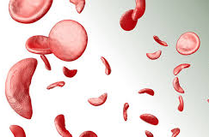
Factors affecting growth and development
Medical factors
(long-term impact of medication, time off school)
Genetic disorders
(for example, sickle cell anaemia, cystic fibrosis)
Pre-natal factors
(pre-conceptual care, diet, smoking, alcohol, drugs, stress, infection)
Birth
(hypoxia, anoxia, premature)
Illness, accidents, injuries
Lifestyles
Diet, poverty, housing, stress, education, play and leisure
Childhood can be a period of great change for some children. Children may experience a range of factors that can impact on their growth and development in a variety of way. This can be positively or negatively. This can also impact them in the short term or in some cases, this can have a more significant impact on their growth and development in the long term.
Look at the factors above that may impact on a child as they grow and develop.
Choose one factor from the list and explain how it may impact on a child, positively and/ or negatively.
Consider the impact of this factor on different areas of development.
You can complete this on the following page.

Slide 13
Factors affecting growth and development

Slide 14

Careers working with children
Working with children is a hugely rewarding and inspirational occupation.
Task:
It is important to broaden your understanding of the careers within early childhood education and those careers that work with children, for example, paediatric nurse.
Research one career options in the early childhood sector (for example, health visitor and early years teacher).
Create a profile including:
Role and responsibilities.
Required qualifications.
Skills and qualities needed
For example, you could consider any of the following:
Mental Health & Wellbeing
Child and Adolescent Mental Health Services (CAMHS) Worker
Counsellor (Child & Adolescent)
Play Therapist
Art Therapist (Children)
Music Therapist (Children)
Educational Psychologist
Mental Health Support Worker (Schools or NHS)
Primary & Secondary Education
Primary School Teacher
Secondary School Teacher
SEN (Special Educational Needs) Teacher
Pastoral Manager
Learning Mentor
Behaviour Support Assistant
Higher Level Teaching Assistant (HLTA)
Early Years
Early Years Teacher (EYT)
Nursery Manager
Teaching Assistant (TA)
Special Educational Needs (SEN) Teaching Assistant
Forest School Leader
Montessori Teacher
Careers
Social Care
Social Worker (Children & Families)
Family Support Worker
Youth Worker
Residential Childcare Worker
Fostering Agency Support Worker
Child Protection Officer
Early Help Practitioner
Adoption Support Worker
Healthcare
Paediatric Nurse
Health Visitor
School Nurse
Midwife (works with infants and families)
Speech and Language Therapist
Occupational Therapist
Physiotherapist (Paediatrics)
Clinical Psychologist (Child & Adolescent)
Child Psychiatrist
GP with special interest in paediatrics
Audiologist (Children’s services)
Dietitian (Paediatric)

Slide 15
Career profile 1

Slide 16


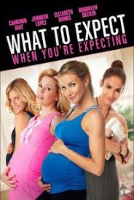



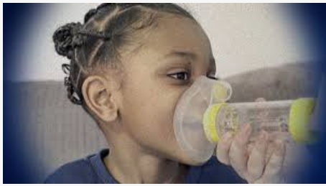

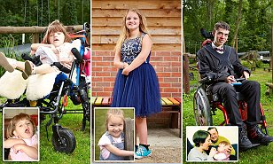

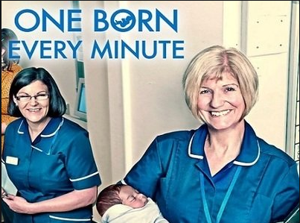
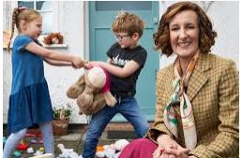
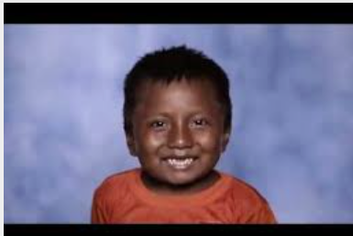

and beyond
Babies
What to expect when you’re expecting
The Children Act
Call the midwife
Netflix
BBC iPlayer
Panorama: Britain’s Mouldy Homes
Jesy Nelson: Odd one out
Panorama: Britain’s Child Health Crisis
BBC iPlayer
Born to be different
Secret life of… Year Olds
One Born Every Minute
4 On Demand
Three Day Nanny
Brain Matters- Early Childhood Development
Poor Kids: Life on the breadline
W Channel
YouTube
https://www.youtube.com/watch?v=Rw_aVnlp0JY
https://www.youtube.com/watch?v=PkssqscrrrU
Recommended Watching for ECD

Slide 17
Learning Log
Record here any additional viewing you are undertaking in order to show what you have been completing in order to prepare you for the course. Use the viewing list on the previous slides you have been given for guidance on what you could you watch.
Complete at least 3 sections
Date | Title | Summary of content | My thoughts

Slide 18

Passport to St John’s Comprehensive Sixth Form Checklist
Use this list to make sure you have everything you need to hand in in September in order to start your AAQ Early Childhood Development.
Three fact files on theorists crucial to child development studies, page 5, 6 and 7.
Completed social stages of play table, page 8.
Highlighted true or false sheet, page 9.
Completed glossary of key terms, page 10-11.
Factors affecting growth and development, page 12 and 13.
Research two careers working with children, page 14, 15 and 16
Complete at least 3 sections of the learning log, page 17 and 18
Further information..
For more information about AAQ Level 3 Early Childhood Development you can find the specification and unit details at the following address..
https://qualifications.pearson.com/en/qualifications/btec-nationals/early-childhood-development-aaq.html
Please email completed AAQ Early Childhood Development Year 11 Transition Packs to Ms Bond at ebond518@stj.kent.sch.uk If you have any questions about the course or any concerns, please email the above email address.

