Slide 1


A-Level Psychology
AQA
Student Hand Book
A Level:
Paper 1 – Introductory Topics in Psychology
Paper 2 – Psychology in Context
Paper 3 – Issues & Options in Psychology
Student Name:
Teachers Name:

Slide 2

Contents
Page 3 – Code of Conduct (Social Sciences)
Page 4 – Introduction
Page 5 – The Course
Page 6-9 – Unit Break down and
Specification
Page 10 – Approaches Research Task
Page 11- Essential resources
Page 12 – 10 Golden Rule
“How to improve my grade”
Page 13 – Suggested Reading
Page 14-22 – Careers in Psychology
“In order to succeed, people need a sense of self-efficacy, to struggle together with resilience to meet the inevitable obstacles and inequities of life.” Albert Bandura

Slide 3
Social Science – Code of Conduct
Code of Conduct
The aim of this contract is to inform you of the sort of behaviour that the Social Sciences Department requires from you while you are studying with us. It will help you to understand the high standards of behaviour and attitude towards learning that we have come to expect from our students.
Whilst undertaking the study of Psychology I
______________________________________________ agree to the following ~
· To be on time for all lessons.
· To come to class fully prepared (i.e. to bring a pen, folder, paper and any required text books).
· Switch off all mobile phones and any other electronic equipment before I arrive in the classroom.
· To show respect for all members in the class and allow them to learn.
· To listen to the teacher when she is giving instructions.
· To listen to other students and not shout out when partaking in discussions and debates.
· To keep noise levels at a suitable level when learning independently.
· To complete all work set to the best of my ability.
· To meet all deadlines set for homework projects.
· To leave the classroom tidy for other students.
Signed
Print Name Today’s Date

Slide 4
Introduction
First of all, welcome to A Level Psychology. This is always quite a hectic time for students & staff alike, so if you are feeling a bit lost, don’t panic, Sixth Form life will settle down eventually (honest!).
Secondly, well done for selecting Psychology as an area of study. Whatever the reasons for your choice I hope that you enjoy this course and you gain much knowledge and pleasure from it.
Psychology is a popular choice among students, it is the science of the mind (Yes it is a Science and don’t let anyone else tell you otherwise!). Most importantly Psychologists study behaviour and you will find that throughout the course it is your own behaviour which will be studied.
This document contains all the information that you need to know regarding your course. It contains (amongst other things) information on exam boards, syllabus areas, curriculum content, and a comprehensive reading list to support your lessons.
Please do keep this document safe, it will be a useful reference booklet in your progression through your course. If you have any questions regarding Psychology, the course or Sixth Form issues in general we can be contacted during class time or via email.
Please complete the Approaches research task on slide 10 and send to either Mrs Collins or Mrs Kelham.
Staff Member | Email
Mrs Kelham | okelham@stj.kent.sch.uk
Mrs Collins | omccormack@stj.kent.sch.uk

Slide 5

The Course
The exam board for your Psychology course this year is AQA. You can find out some more information about this in detail by visiting the AQA website. Please follow the link and click on the ‘UPDATED’ specification.
https://www.aqa.org.uk/subjects/psychology/a-level/psychology-7182
You will sit three exam papers at the end of year 13. Further detail of these is provided on the following pages.

Slide 6

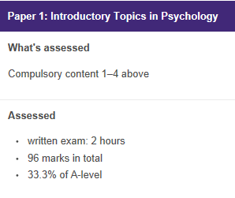
Paper 1: Introductory Topics in
Psychology
This unit is designed to introduce you to some of the key and most influential topics in Psychology.
A Level
Topics:
Social Influence
Memory
Attachment
Psychopathology
All studied in year 1

Slide 7

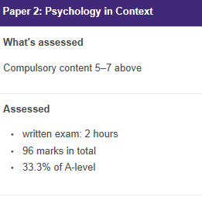
Paper 2: Psychology in
Context
This unit is designed to enable you to apply concepts we have learned so far to real life.
Research Methods (Studied in year 1&2)
A Level
Topics:
Approaches
Bio Psychology (Studied in year 1)

Slide 8
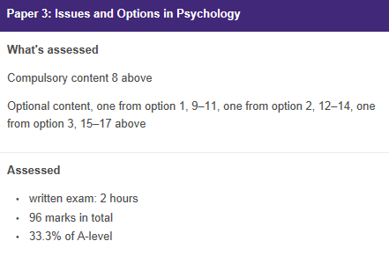
Paper 3 – Issues and Options in Psychology
This Unit is the most advanced of all of the units and is only taught in year 2. It requires you to take a wider outlook on the topics studied by considering the different issues, debates and approaches .
Topics
Issues and debates
+
Three Option Topics (all studied in year 2):
Aggression
Schizophrenia
Gender

Slide 9
Exam Questions and Assessment Objectives
You will be required to answer a range of exam questions both in lessons and for homework.
At A Level exam questions include multiple choice, short answer and extended answer questions worth 16 marks. You will be expected to show greater insight of issues, debates and approaches in Psychology, as well as more developed evaluation.
How will I be assessed? What are the skills I will need?
You will be assessed using three key assessment objectives (AO’s). These also detail the skills you will need to perfect whilst on the Psychology course.
AO1 – Knowledge and Understanding: You can do this in an exam by describing or outlining studies or theories in detail using key terms. By doing this you are showing you know and understand!
AO2 – Application: In an exam situation you might be given a scenario or stimulus to apply your psychological knowledge to. To do this you have to really interpret theories, concepts and studies and select the most appropriate ones to talk about, linking back to the scenario you are given.
AO3 – Analysis & Evaluation: In an exam this is the critical thinking assessment objective. To achieve this you need to discuss strengths and weaknesses of Psychological theories and studies. You may also make comparisons by considering which theories/studies are the best.

Slide 10
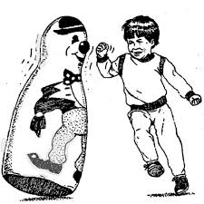
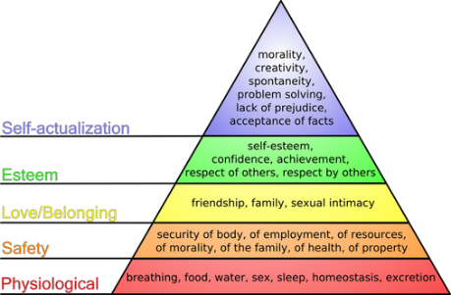
TASK- Approaches Research
Approaches in Psychology
There are some core approaches to Psychology that you need to know for A level – they are different ways of explaining human behaviours. Some of these are listed below: your job is to do some research on them using the internet. There are also plenty of great videos on YouTube you can watch.
For each of the approaches listed below you should find out:
A brief background of the approach.
How it explains human behaviour.
Identify one key researcher from this area – and why they are famous.
Approaches:
The Behaviourist Approach
The Social Learning Theory Approach
The Cognitive Approach
The Biological Approach
Optional extension: Conduct the same research with the Psychodynamic Approach & Humanistic Approach

Slide 11
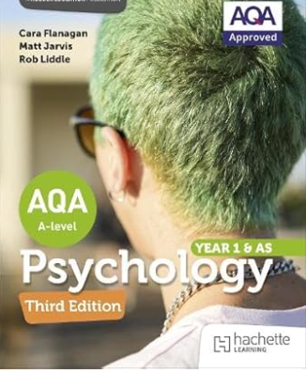

Essential Resources
Textbooks
The AQA A level Psychology book is an essential resource. You will need the third edition to reflect the new specification changes
P.S. Don’t forget to read the pages on exam skills at the back!
An alternative book you can use is the Complete Companion. This is not endorsed by AQA but is in line with the specification. Ensure you get the sixth edition to reflect the new specification.
Useful websites:
https://www.psychologytoday.com/gb
https://www.simplypsychology.org/
https://www.tutor2u.net/psychology/collections
Videos
Type psychology into YouTube and take your pick. There are TED Talks, Crash Course videos and so much more.
https://www.youtube.com/@PsychBoost

Slide 12
10 Golden Rules
How to improve my grade.
1. Start your course with an organised Psychology folder and keep it this way. You will be surprised just how important this organisation is. A level is as much about organisation as they are about hard work.
2. Produce a vocabulary book and always update this at the end of each week. Ask your teacher for definitions if you are not clear.
3. Do not just collect key words. Use them in homework and in class to make sure you understand them and can use them in the right context.
4. Make flash cards for key concepts, perspectives and research, keep them in your folder.
5. At the end of each topic spend some time making revision notes. This requires good discipline and organisation, but it will pay dividends when the course ends and you approach the final exams.
6. List evaluation points for each topic you study. Put these onto revision cards and learn them when you have completed the topic.
7. Put all your named examples for each topic onto separate revision cards. You should include what sociologists did, what they said and which perspective they follow.
8. For every theory you cover you should:
• Make 10 bullet point statements about the perspective
• Identify 10 key concepts the perspective would use
• Name 3 studies related to the perspective?
• Outline 3 criticisms of the perspective?
• Be able to compare and contrast with other perspectives
9. For each study try and remember the theory it’s related to and the method used.
10. Be able to evaluate theories by comparing and contrasting with other (often opposing) theories.
A*

Slide 13


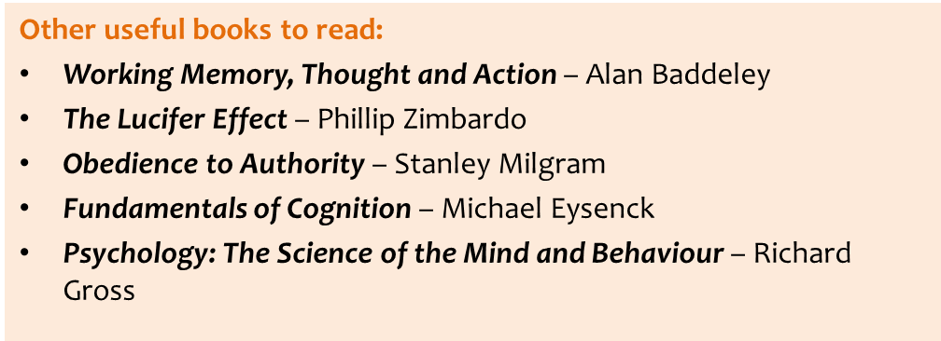
Additional Reading
Richard Gross:
Psychology: The Science of Mind and Behaviour
Grahame Hill:
AS and A Level Psychology Through Diagrams: Oxford Revision Guides. For old specifications but really useful diagrams of the key content in Psychology.

Slide 14

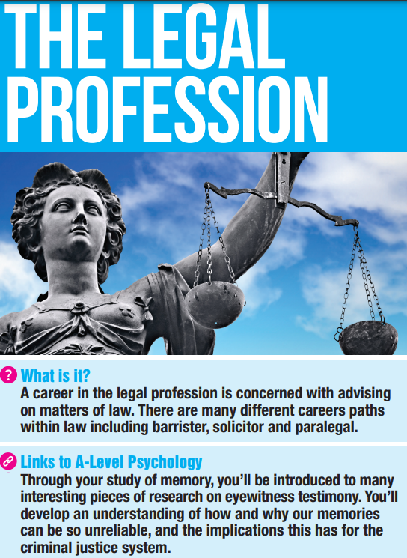
Careers in Psychology

Slide 15
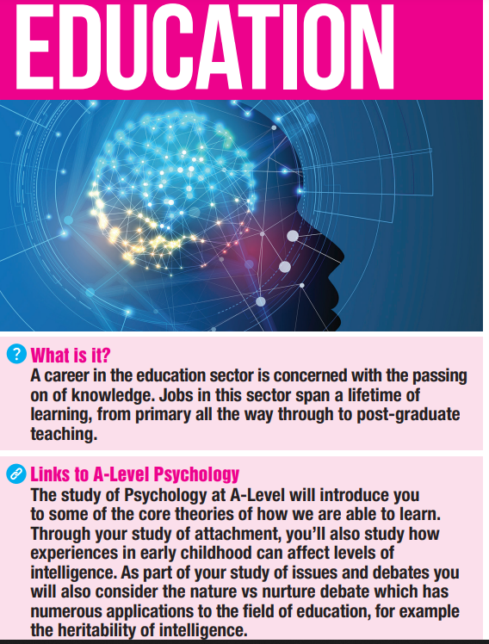
Careers in Psychology

Slide 16
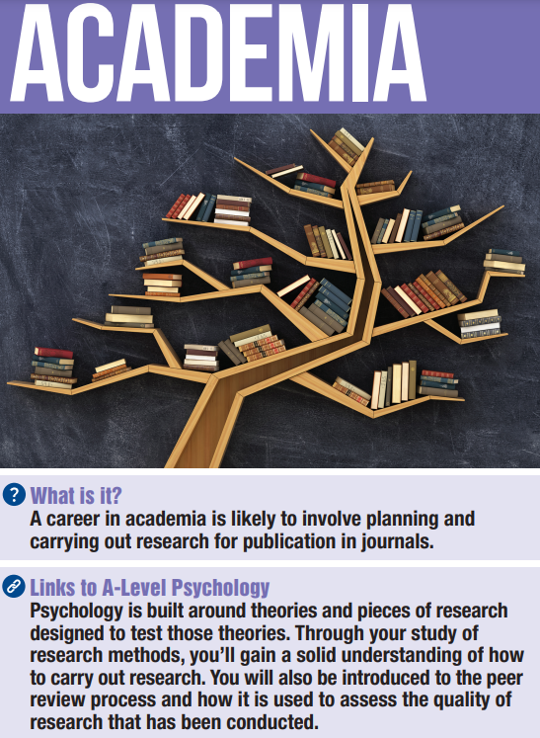
Careers in Psychology

Slide 17
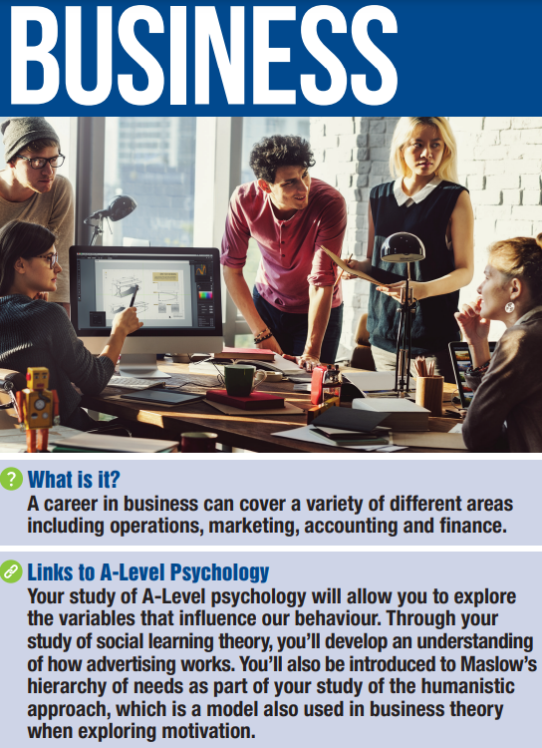
Careers in Psychology

Slide 18
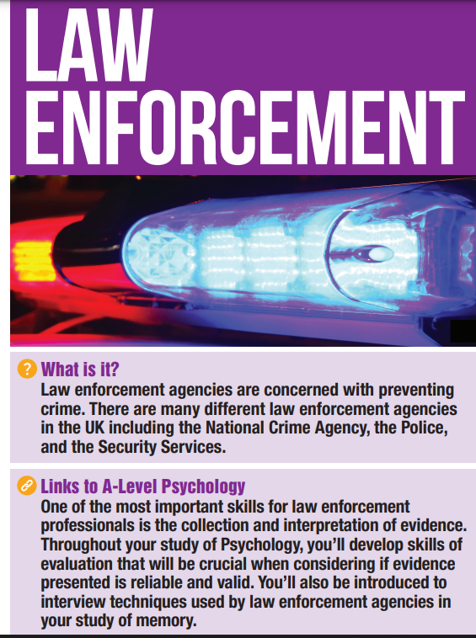
Careers in Psychology

Slide 19
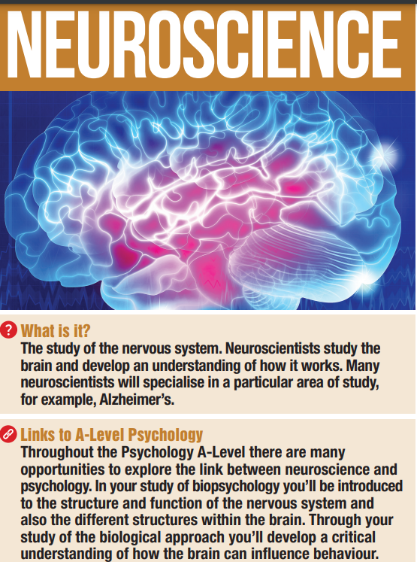
Careers in Psychology

Slide 20
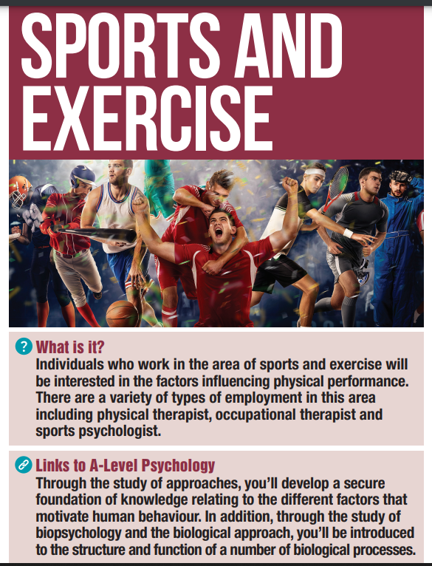
Careers in Psychology

Slide 21
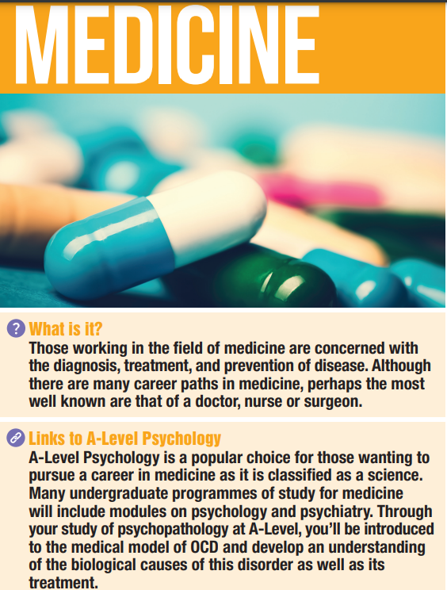
Careers in Psychology

Slide 22
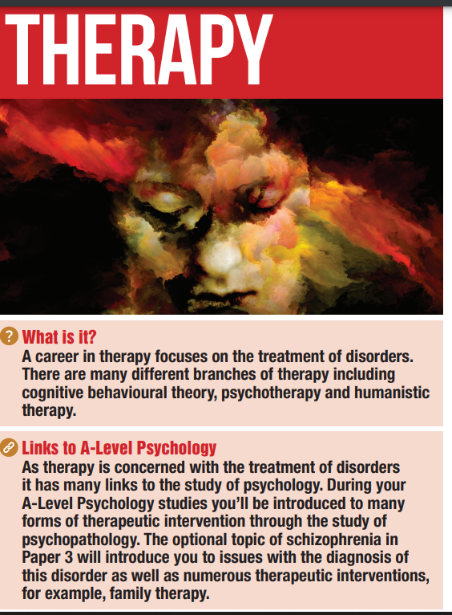
Careers in Psychology

