Slide 1
How to fill out your UCAS application

Slide 2
UCAS Application Timeline
July 2020
Research courses, attend open days and summer school
Complete Personal Statement
8th September 2020
Application process opens.
15th October 2020
Deadline for medicine and veterinary applications and Oxbridge
Late May 2021
Deadline for student finance
Arrange accommodation if necessary
15th January 2021
Deadline for all other applications. Some UCA applications have until March
Early May 2021
Deadline for accepting offers
First choice and insurance

Slide 3
Completing the application
Maximum of five choices
Some choice restrictions:
  Medicine, veterinary, dentistry – max. four
  Oxford or Cambridge
Simple application cost:
  One choice – £20
  Two-five choices – £25
Application is entirely online through the school
Buzzword this year is “Ambitions”

Slide 4
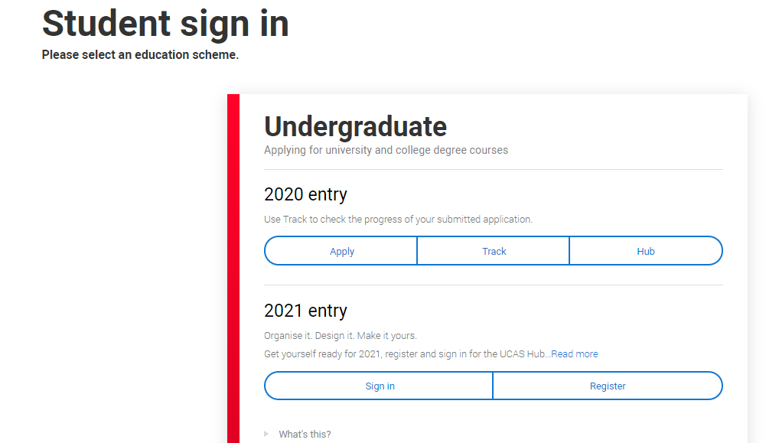
Setting up a profile on UCAS
2021 entry @UCAS.com

Slide 5
Tips for registering
Choose the correct year for registration 2021
Check all details are correct
Use capital letters for names and places
Use your personal e mail address NOT your school e mail address
Make a note of your answers to the security questions
Make a note of your username and password (I cannot access your account if you forget these)
You will be asked to verify your e mail address and then be given a unique ID number. Again make a note of this as you will need to quote it if you need to communicate with UCAS or universities at any time.

Slide 6
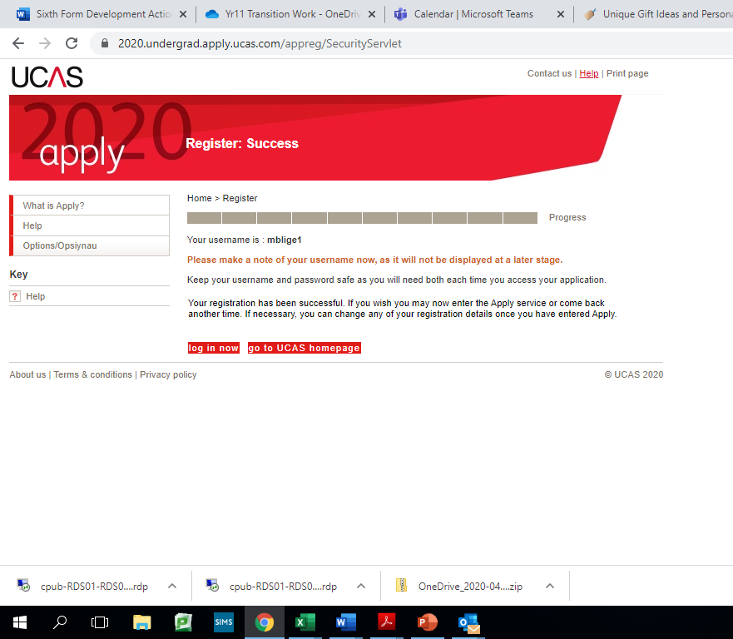
Make a note of your username and password
Make a note of you ID number

Slide 7
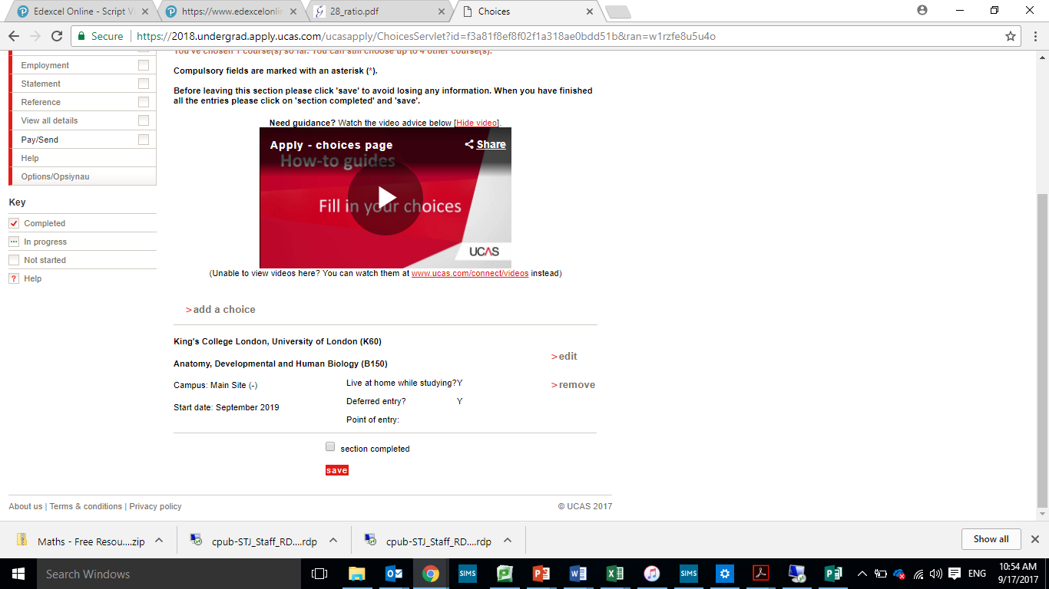
Apply for up to 5 courses
You can add more as you go
2-5 choices £25

Slide 8
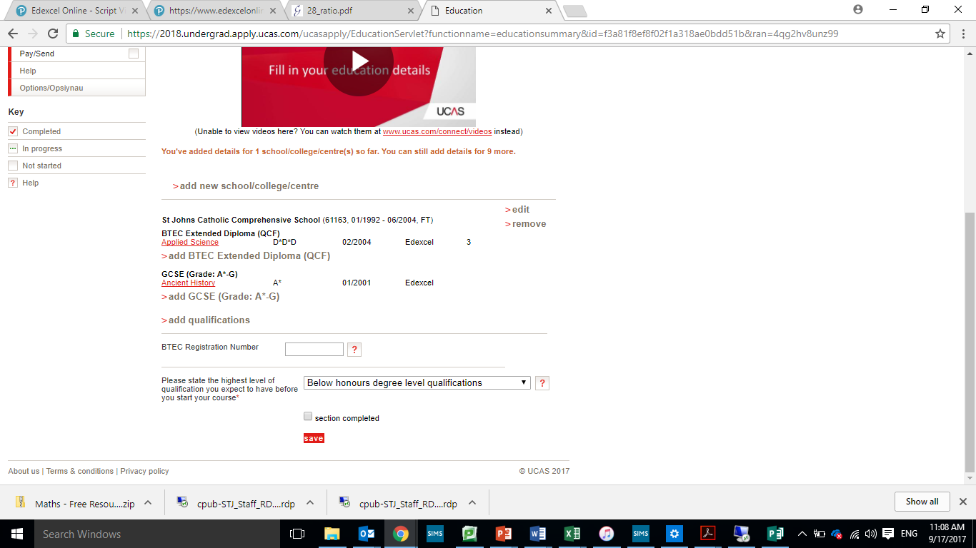
Add all schools and qualifications
Check the qualification is correct, especially BTEC (use QCF)
E mail Mrs Ainscow for your BTEC registration number
Level 3 qualification results will be pending
Enter the correct year of qualification
Enter qualifications that you have achieved in ALL schools
Make sure you have the correct entry and leaving dates for each school
Leaving date for you at St John’s will be July 2021

Slide 9
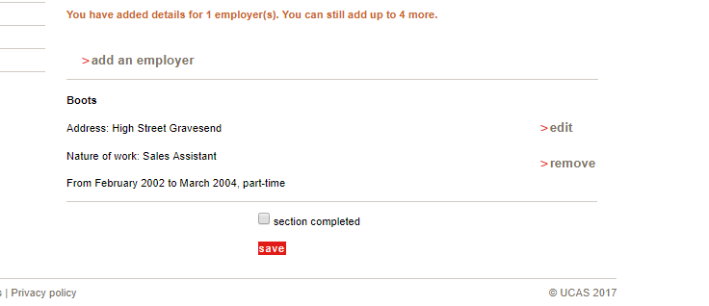
Add any part time employment here
Also add any volunteering or work experience

Slide 10
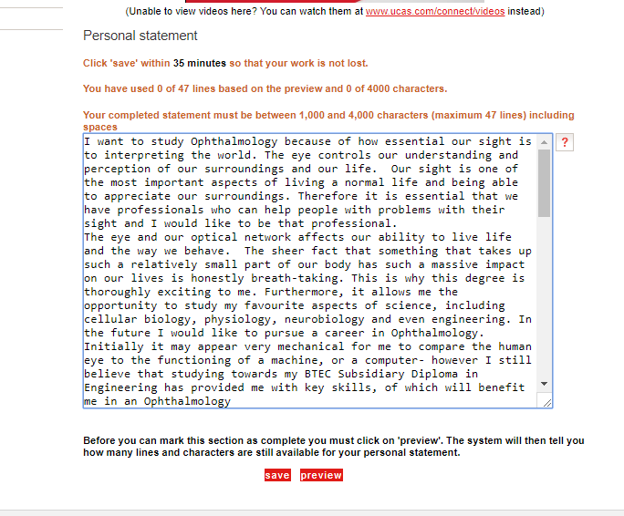
Prepare in word and spellcheck
Ask form tutor to look through it first
Remember to save regularly
Only 4000 characters allowed
Take time on this. Seethe UCAS tool for help

Slide 11
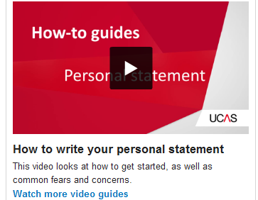
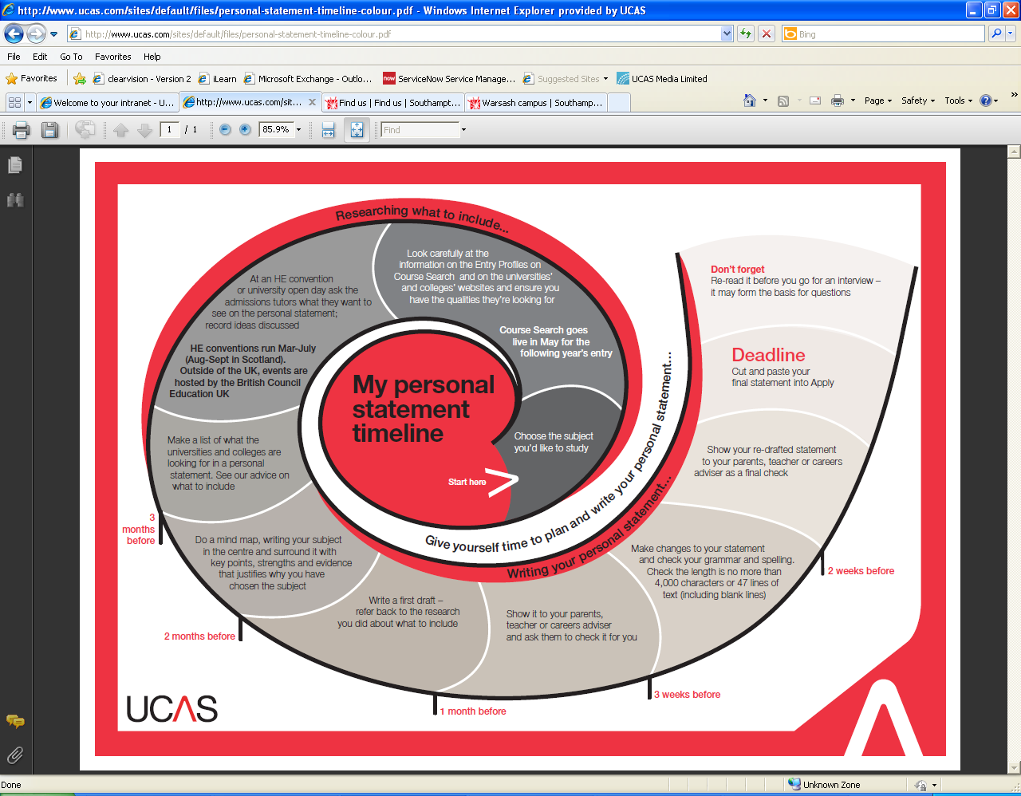
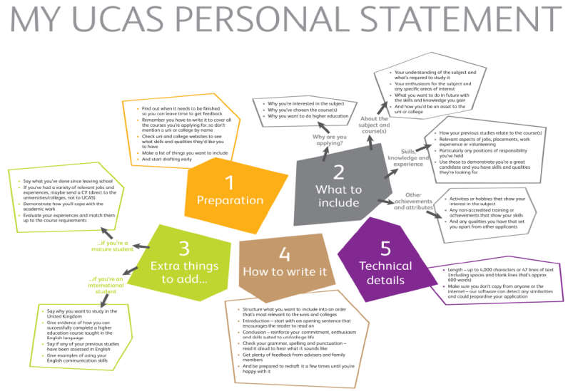
Personal statement
Resource tool
https://www.ucas.com/undergraduate/applying-university/how-write-ucas-undergraduate-personal-statement

Slide 12
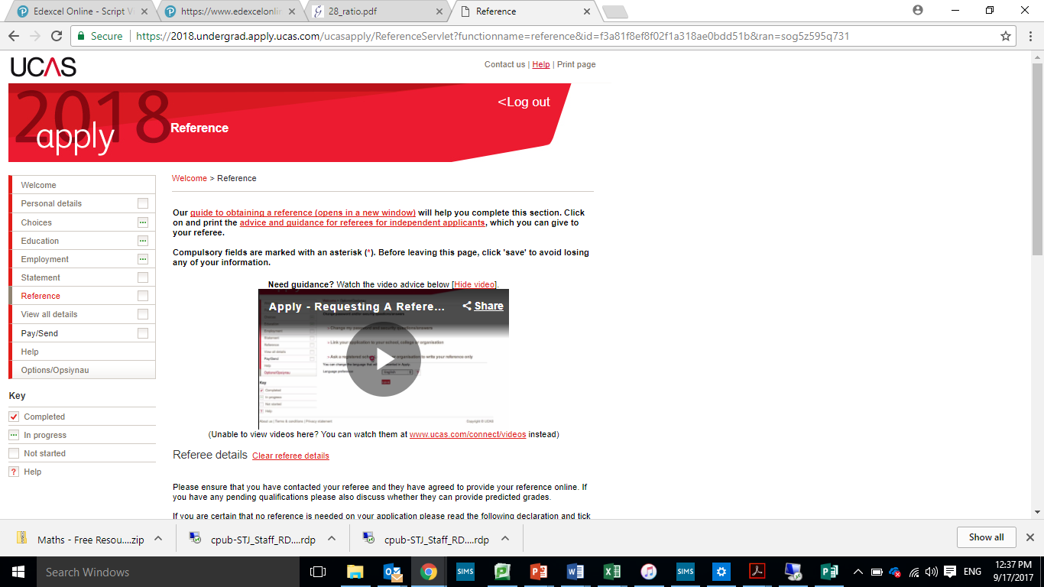
Reference is completed once application has been sent and paid for. Predicted grades are added by the school
Comes via the school who complete it then send the applications to UCAS
Payment must be made through card
Application will not go through until all sections are complete and the box has been ticked to say they are complete

Slide 13
Tracking applications
Track will allow you to:
follow the progress of your application online
see your choices and personal information
see your offers
reply to offers online

Slide 14
When to apply
Mid September Applications can be submitted to UCAS
15th October 2020 Medicine, veterinary, and dentistry
Oxford or Cambridge
15th January 2021 Entry deadline for ALL other courses
25th February 2021 - UCAS Extra opens.
30th June 2021 - Applications received after 30th June are entered in to Clearing
4th July 2021 - UCAS Extra closes.
5th July 2021 - UCAS Clearing Opens

Slide 15
Decisions and replies
Provider decisions:
Unsuccessful
Unconditional offer
Conditional offer – qualifications and achievements and/or UCAS Tariff points
FIRM = where you really want to go
INANCE =
Once all decisions are received, they can hold up to two offers:
One as your firm choice
One as your insurance choice (if you want to)
All other offers are declined
Track will show your reply date.

Slide 16
Other options
Extra Feb – July
If all five choices have been used and you have no offers/rejected all offers.
Clearing from early-July
If you have no offers, or have applied after 30th June deadline.
Adjustment
(from A level results day)
If you have gained better results than the conditional offer they hold, you could apply for
a different course or university.

Slide 17
Points to Remember
You are the only one can access your account. If you have any problems, you need to contact UCAS direct
I can only complete your reference once your application gets sent to me
You can only make changes then if I send it back to you (I check ALL applications) You then must send it back to me via UCAS
The deadline is non-negotiable
You have to declare ALL your qualifications
Your teachers will have a say in your predicted grades
It is a good idea to nominate a member of your family to access your account should you not be able to
See me if you are interested in applying for Oxford or Cambridge

Slide 18
How can your parents support the
application process?
Use the parents/guardians section of the UCAS website/Parent Guide publication – www.ucas.com/parents and sign up for the newsletter.
Offer to attend open days, you may have a different perspective.
Don’t book family holidays at key times.
Make sure they read everything carefully that is sent to them.
Support your son/daughter’s management of their application.

Slide 19
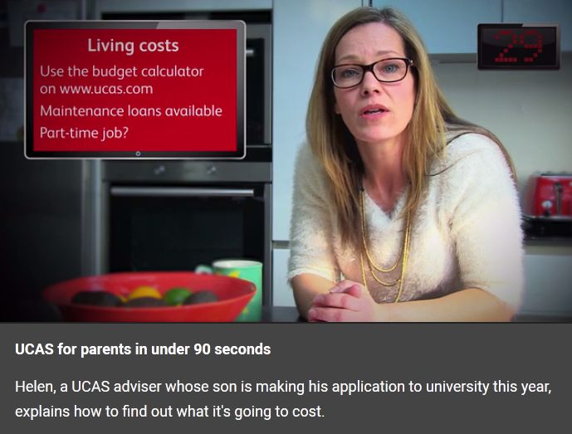
Videos for students and parents
UCAS has developed four videos on key topics:
The UCAS process
Open days
Student finance
Clearing
FIRM = where you really want to go
INSURANCE =
you would be happy to
get into
your FIRM choice
INSURANCE = somewhere
you would be happy to
get into
your FIRM choice
www.ucas.com/parents

Slide 20


Slide 21
QUESTIONS?

