Slide 1
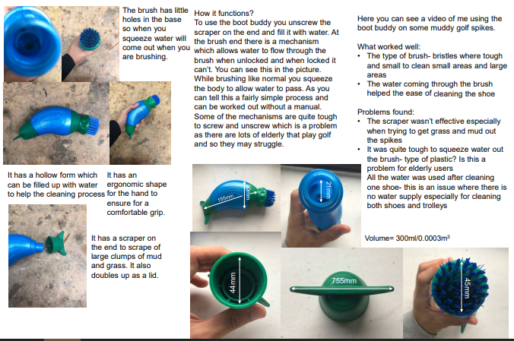
Example of existing product research
You must include the following points in analysing each existing product:
Annotation must be analysed, explained and discuss:
materials,
cost,
size,
Function
You must also summarise each design with your likes and dislikes about each product.

Slide 2
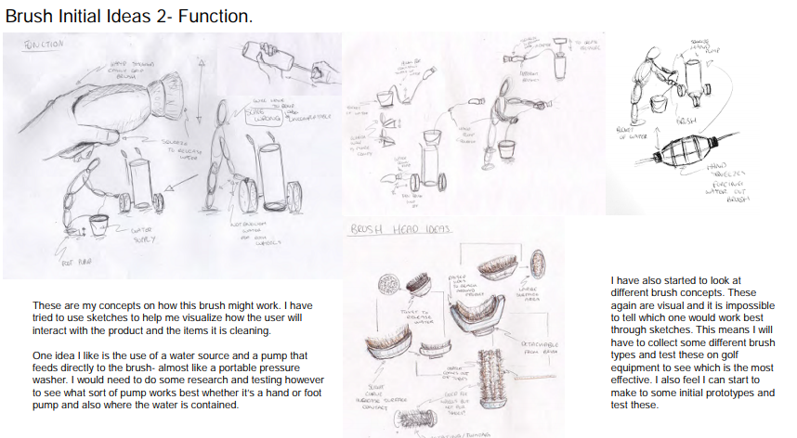
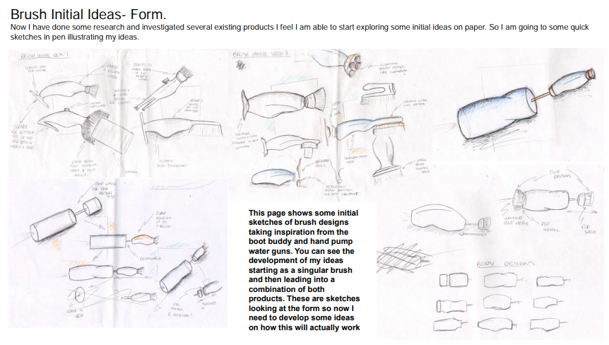
Example of Initial design ideas
You must include annotation about each design and its features, like joints, adhesives, materials, size, function, how it could be manufactured, environmental impact, safety, etc. Analyse areas you can not see from a drawing eg back view.

Slide 3
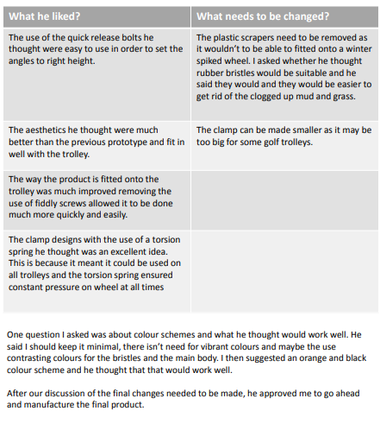
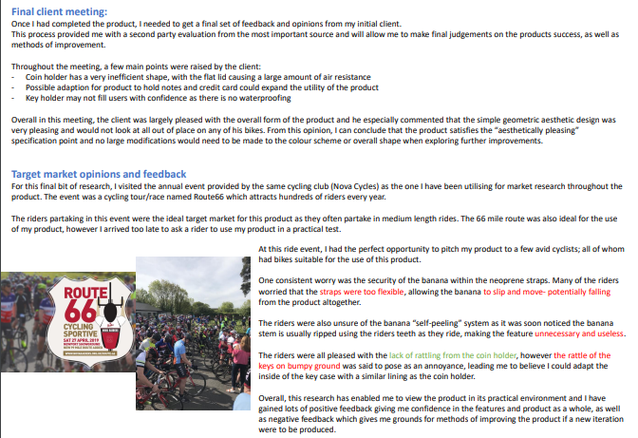
Example of third party feedback

Slide 4
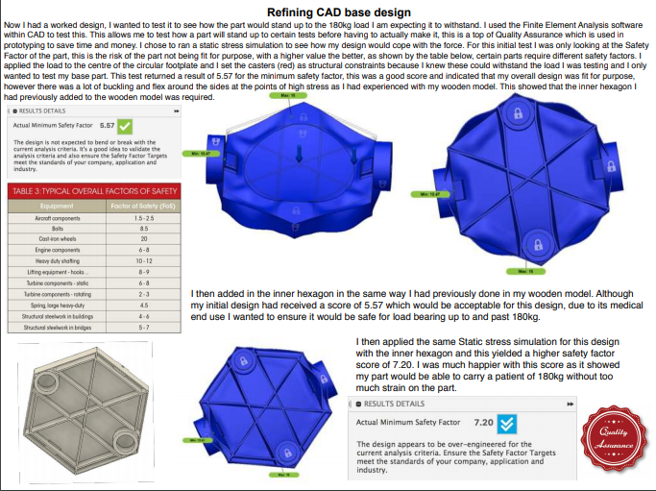
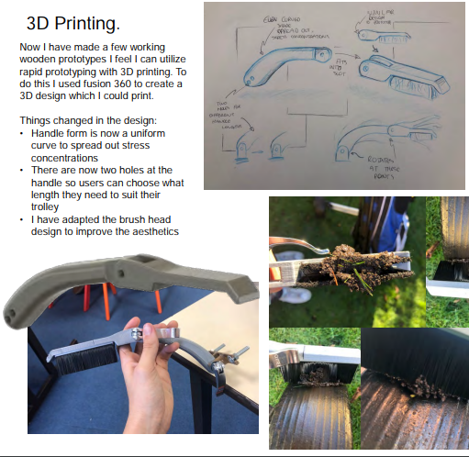
Example of third party feedback
Select one or two of your initial designs and improve and develop a final design using the third party feedback. You must include annotation about the improvement of the design and why you change it. Also, annotate features you can not see from a drawing, like materials, size, function, how it could be manufactured, environmental impact, safety, etc.

