Slide 1
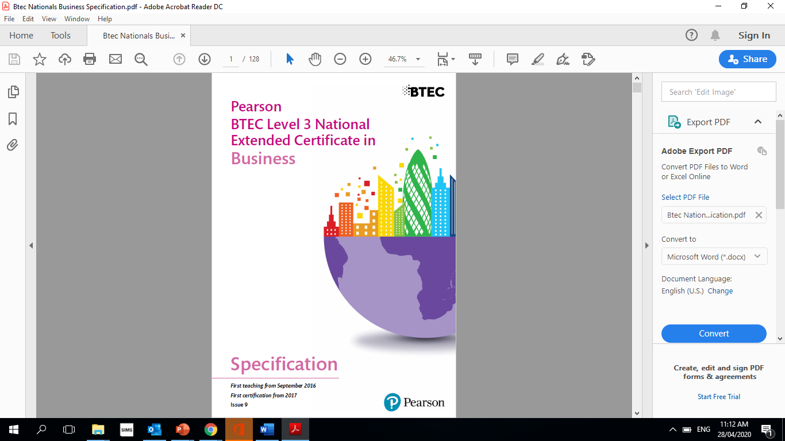
Level 3 BTEC National Extended Certificate in Business
Passport to Sixth Form
Name: ________________________

Slide 2

Contents
Contacts Page 3
Course structure Page 4-8
Reading List Page 9
TV Programmes Page 10
Recommended films and
Netflix programmes Page 11-14
Recommended Reading Page 15
Research Task 1 Page 16
Research Task 2 Page 17-18
Learning Log Page 19
Home Learning Activities Page 20-22
Optional Task Page 23
Passport Checklist for September Page 24

Slide 3
Contacts
Mr J Karnovski
jkarnovski@stj.kent.sch.uk
Ms M Noor
mnoor@stj.kent.sch.uk
Mrs D Donkor
ddonkor@stj.kent.sch.uk

Slide 4
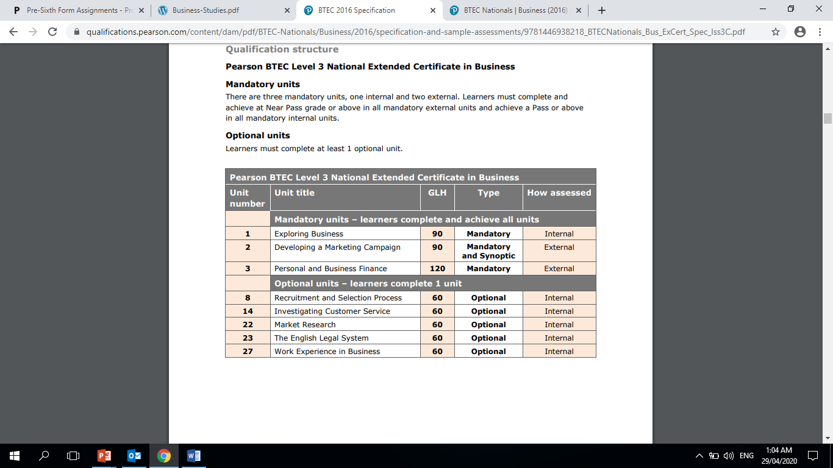
Course Structure
I will be assessed on…
My Level 3 Qualification consists of four units and is an Extended Certificate equivalent to 1 A-Level and is marked at a Pass, Merit or Distinction. All units must be passed in order to achieve a full qualification.

Slide 5



Unit 1 Exploring Business
Learning Aims
Explore the features of different businesses and analyse what makes them successful B. Investigate how businesses are organised C. Examine the environment in which businesses operate D. Examine business markets E. Investigate the role and contribution of innovation and enterprise to business success.

Slide 6
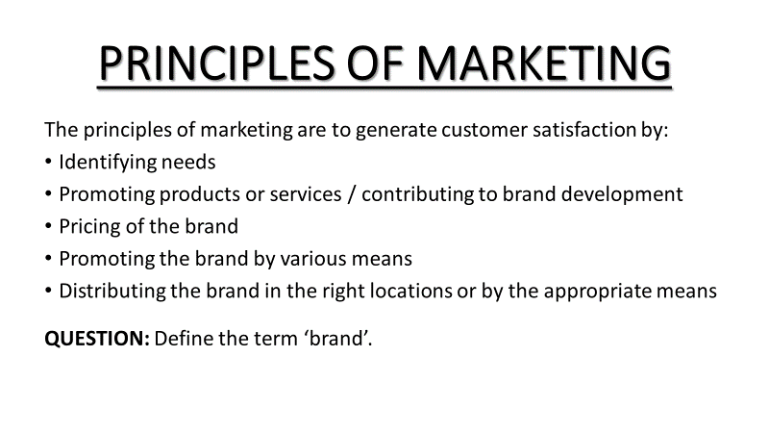



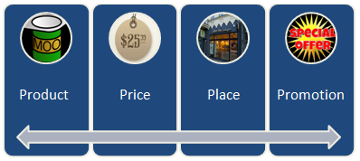
Unit 2 Developing a marketing Campaign
This unit is assessed under supervised conditions. Part A is released two weeks ahead of part B. It is marked externally.

Slide 7
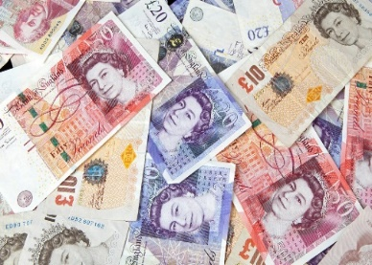



Unit 3 Personal and Business Finance
Learning Aims
Understand the importance of managing personal finance
Explore the personal finance sector
Understand the purpose of accounting
Select and evaluate different sources of business finance
Break even and cash flow forecasts
Complete statements of income and financial position and evaluate a business’ performance
This unit is externally marked and assessed under supervised examination conditions.

Slide 8



Unit 8 Recruitment and Selection
Learning aims
Examine how effective recruitment and selection contribute to business success
Undertake a recruitment activity to demonstrate the processes leading to a successful job offer
Reflect on the recruitment and selection process and your individual performance

Slide 9
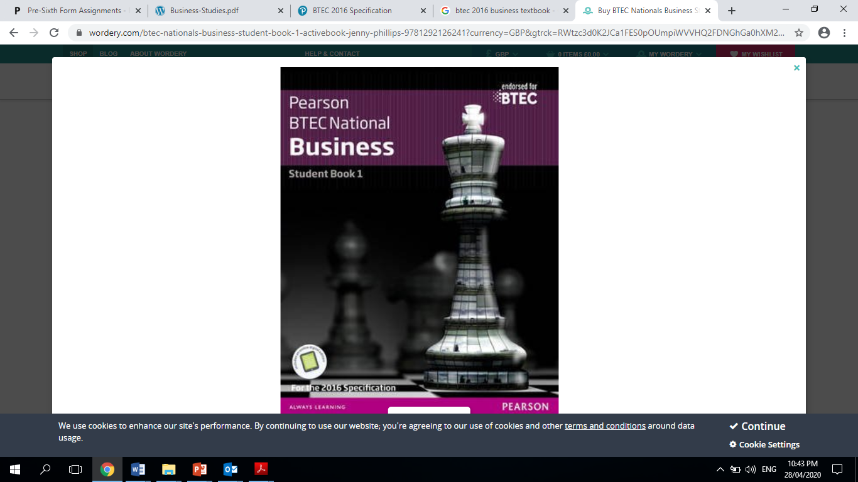


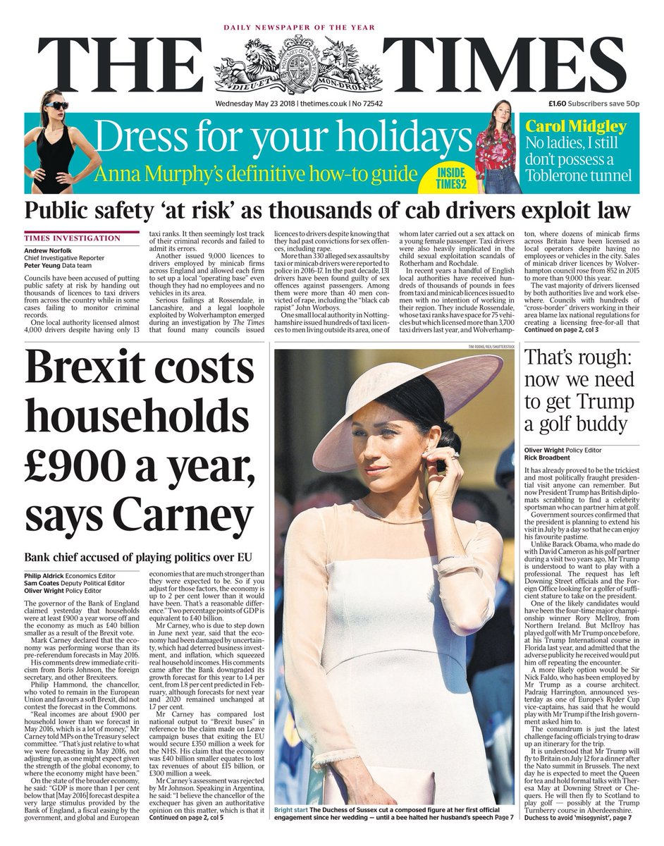


Reading List
BTEC Nationals Business Student Book
Publisher: Pearson
Author: Jenny Phillips,Helen Coupland-Smith,Catherine Richards,Julie Smith,Ann Summerscales
ISBN: 9781292126241
Revise BTEC National Business Revision Workbook
Publisher: Pearson
Author: Claire Parry,Steve Jakubowski,Diane Sutherland,Jon Sutherland
ISBN: 9781292150116
Revise BTEC National Business Revision Guide
Publisher: Pearson
Author: Diane Sutherland,Jon Sutherland,Steve Jakubowski
ISBN: 9781292230566
Other recommended reads - Quality newspapers/magazines such as The Times, Guardian, Telegraph, Independent, journals such as The Economist (N.B there are reduced rates for students on some of these, for example, students were able to buy The Economist for 6p per copy instead of the standard £2!) Also, you can sign up online and receive free articles.

Slide 10




TV - Recommended Watching for Business Studies
-
BBC News
Latest news from around the world.
BBC Panorama
British current affairs documentary programme
Dragons Den
Programme about entrepreneurs presenting their business ideas to gain funding from the Dragons. (Venture Capitalists)
The Apprentice
Programme about entrepreneurs working in teams and being interviewed so they can gain backing from Sir Alan Sugar for their business idea.

Slide 11


Films - Recommended Watching for Business Studies
Up In The Air with George Clooney (2010);
Up in the Air is a 2009 American comedy-drama film directed by Jason Reitman and written by Reitman and Sheldon Turner, based on the career of J Weller. The story is centered on corporate "downsizer" Ryan Bingham (George Clooney) and his travels.
Business reference: Human Resources, retrenchment
Enron: The Smartest Guys in the Room (2005);
The film examines the 2001 collapse of the Enron Corporation which resulted in criminal trials for several of the company's top executives during the ensuing Enron scandal it also shows the involvement of the Enron traders in the California electricity crisis.
Business reference: Profit, Public Limited Companies, Stock market, insider trading

Slide 12


Films - Recommended Watching for Business Studies
Glengarry Glen Ross” (1992)
This film follows the lives of four unethical Chicago real estate agents who are prepared to go to any lengths (legal or illegal) to unload undesirable real estate on unwilling prospective buyers.
Business reference: Profit
Pursuit of Happyness
The Pursuit of Happyness is a 2006 American biographical drama film based on entrepreneur Chris Gardner's nearly one-year struggle being homeless. Directed by Gabriele Muccino, the film features Will Smith as Gardner, a homeless salesman.
Business reference : Entrepreneurial spirit, sales, finance

Slide 13



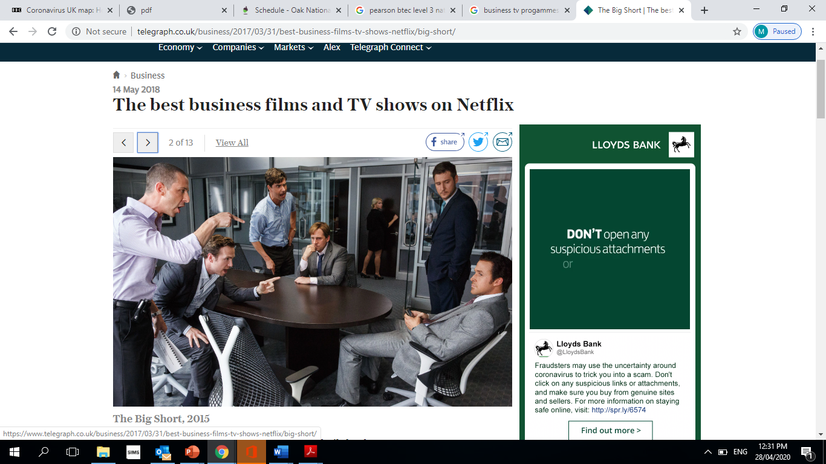
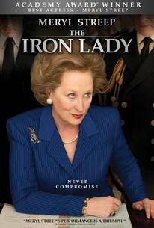
Made in Dagenham
Churchill
The The True cost
The Iron Lady
Recommended Watching for Business Studies

Slide 14


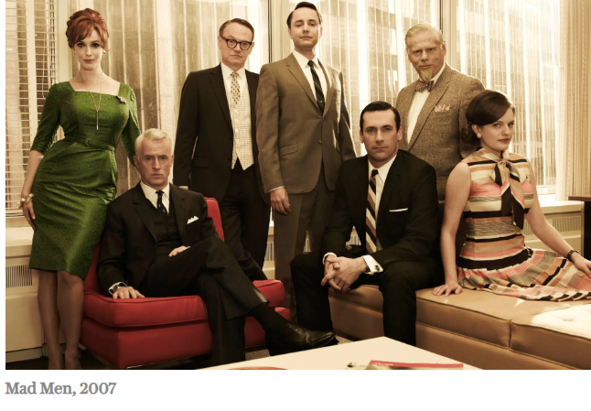
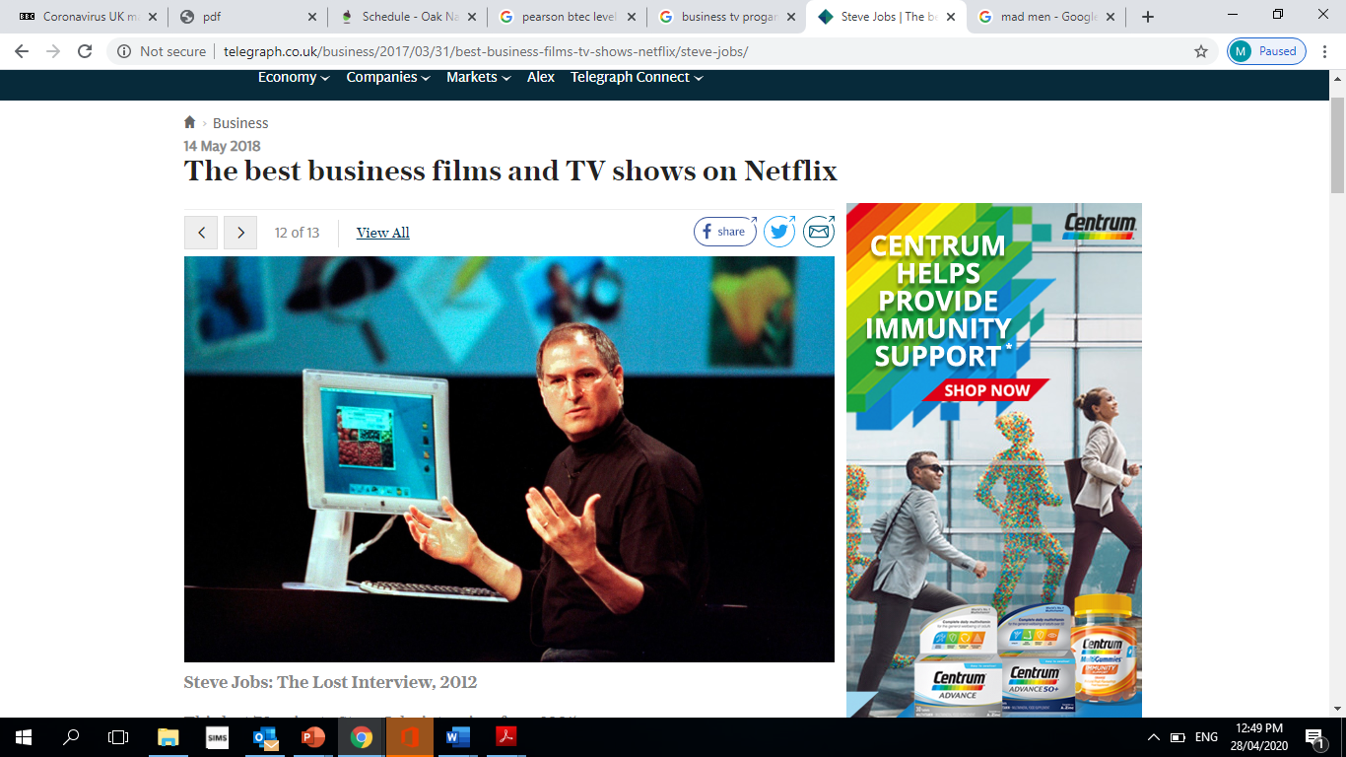
The social network
Boom bust Boom
Mad men
The Steve Jobs; the last interview
Recommended Watching for Business Studies

Slide 15


Beyond
Further Reading
The Hate U Give by Angie Thomas
Me Before you by Jojo Moyes
The Fault in Our Stars by John Green
The Story of Baby P by Ray James
Savage Girls and Wild Boys by Michael Newton
The Language of Kindness by Christie Watson
I am Malala by Malala Yousafzai
The Boy Who Couldn’t Stop Washing by Dr Judith Rapaport
Recommended Reading for Business Studies
Yes some of these are also films, if you prefer!

Slide 16
Research Task 1
Select a company (Picking a Public Limited Company (PLC) will make it easier to find information on the internet).
Present your information as a report, PowerPoint presentation or poster. Research some basic facts: Research and explain the term “PLC” Download the your chosen “PLC’s” annual accounts Read the chairman’s and CEO message at front of the pack Look through the pack to find the financial information (Income statement) this will show the revenue and profit. Explain the following What does the business do? How large is it? Where is it based? What are its key objectives? (Hint: look in the Chairman’s statement in the annual report)
How successful is it? Give evidence (Think about numbers: sales revenue, profit, market share etc. and get facts and figures).
Has it become more or less successful over the last few years? (again, get evidence from annual report, compare finance for a few years)
What do you think are the key factors that affect its success and why? (Think about competitors, Government regulation, the economy, its financial situation etc.)
Evaluate what impact the coronavirus has on this business?

Slide 17
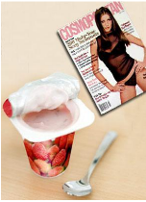
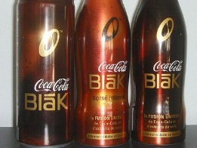
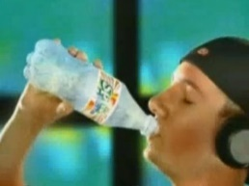

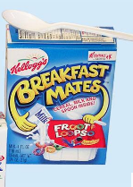



Research Task (2) - Unsuccessful Branding
Many top businesses have launched brands unsuccessfully:
  Dasani water
  Coca Cola Blak
  McDonald's Arch Deluxe
  Colgate Kitchen Entrees
  Kellogg's Breakfast Mates
  Bic Underwear
  Sprite Remix
  Cosmopolitan Yoghurt

Slide 18

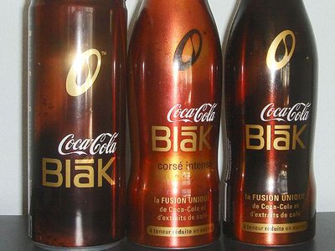


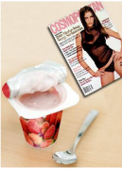

Research Task (2)
Research ONE of the unsuccessful brands shown.
Try to find out what was wrong with the brand.
What people thought about it.
Explain how this would affect the business.
Describe your findings to the rest of the class

Slide 19
Home Learning Activity Log
Record here any additional activities you have undertaken to show how you have prepared for the course.
Select activities from the home learning activity slides.
Complete at least two activities.
Bring evidence of your activities to your first lesson.
Date | Activity Completed

Slide 20




Home Activities (1)
“A week in Business”.
1 | Select 7 pictures, one for each day to represent a business news story. ( see if there is something different happening not just Coronavirus)
2 | For each story, write a commentary/explanation: What is happening What has it got to do with business Why is it important?
3 | Select the story that you found most interesting. Why was this?
4 | Create a poster showing your pictures

Slide 21

Home Activities (2)
Choose six companies/brands and research them!
Find out the following – Ownership type, Revenue, Profit, Number of employees, size, name of leader (CEO).
Any other interest facts!!

Slide 22
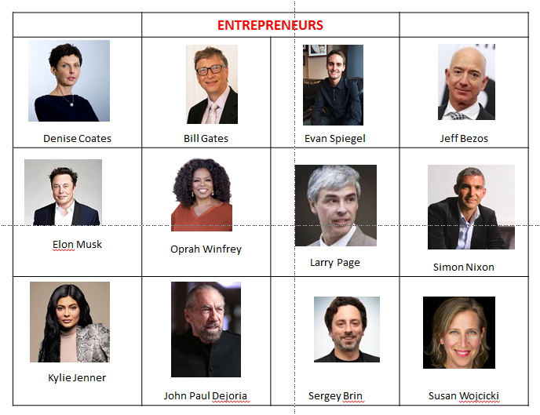
Home Activities (3)
Research six different entrepreneurs and find out the following: -
What have they done?
Why are they an entrepreneur?
How did they do it?
What is their net worth?

Slide 23
Optional Task
Other Useful Preparation for the Course
• Go to – www.tutor2u you can answer a quiz on topics relating to business and find additional support in the form of presentations and case studies to support your understanding of the subject.
Get into the habit of following the news: both in newspapers and by watching television programmes such as:
• The Hotel Inspector
• Channel 4 News
• Dispatches
• Running the Shop
• Panorama
Popular websites to use include:
• www.businessEd.co.uk
For a really good head start on the course, consider reading the following books:
Common Sense Rules: What you really need to know about business, Deborah Meaden
Anyone Can Do It, Duncan Bannatyne

Slide 24
Passport Checklist
Use this list to make sure you have everything you need to hand in in September in order to start your Level 3 BTEC in Business Nationals .
Task 1
Task 2
Home Learning Activities
Optional Task
Further information..
For more information about BTEC Level 3 National in Business you can find the specification and unit details at the following address. https://qualifications.pearson.com/en/qualifications/btec-nationals/business-2016.html
Please email completed Business Studies Year 11 Transition Packs to Mr Karnovski jkarnovski@stj.kent.sch.uk . If you have any questions about the course or any concerns, please email the above email address.

